Slide 1


Strengthening OFCY Outcome Reporting
February 6, 2026
Presented by: The Bridging Group

Slide 2
Welcome & Opening Remarks
City of Oakland Human Services Department and OFCY Leadership

Slide 3

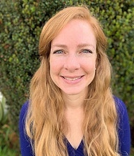
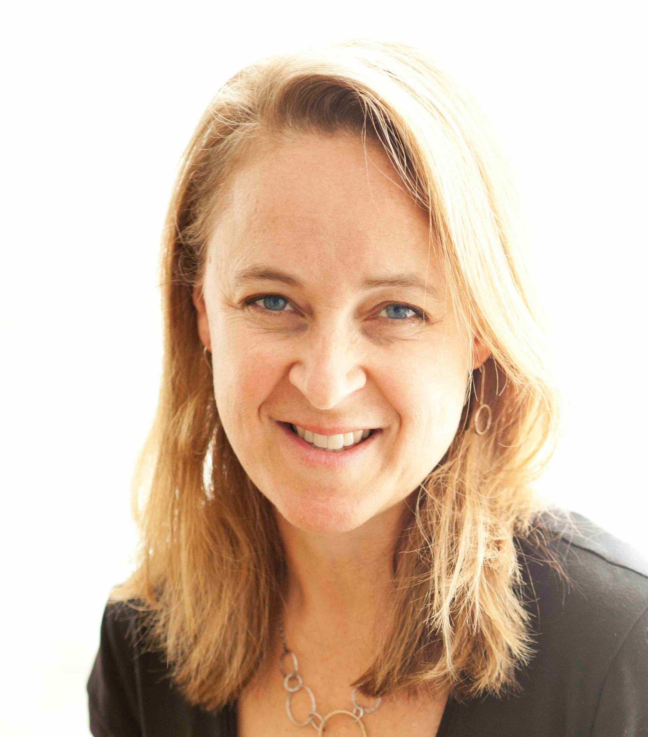
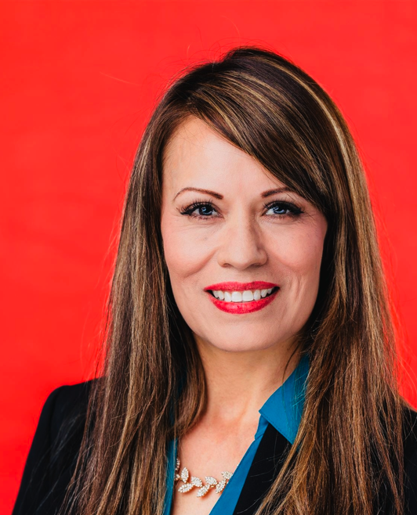
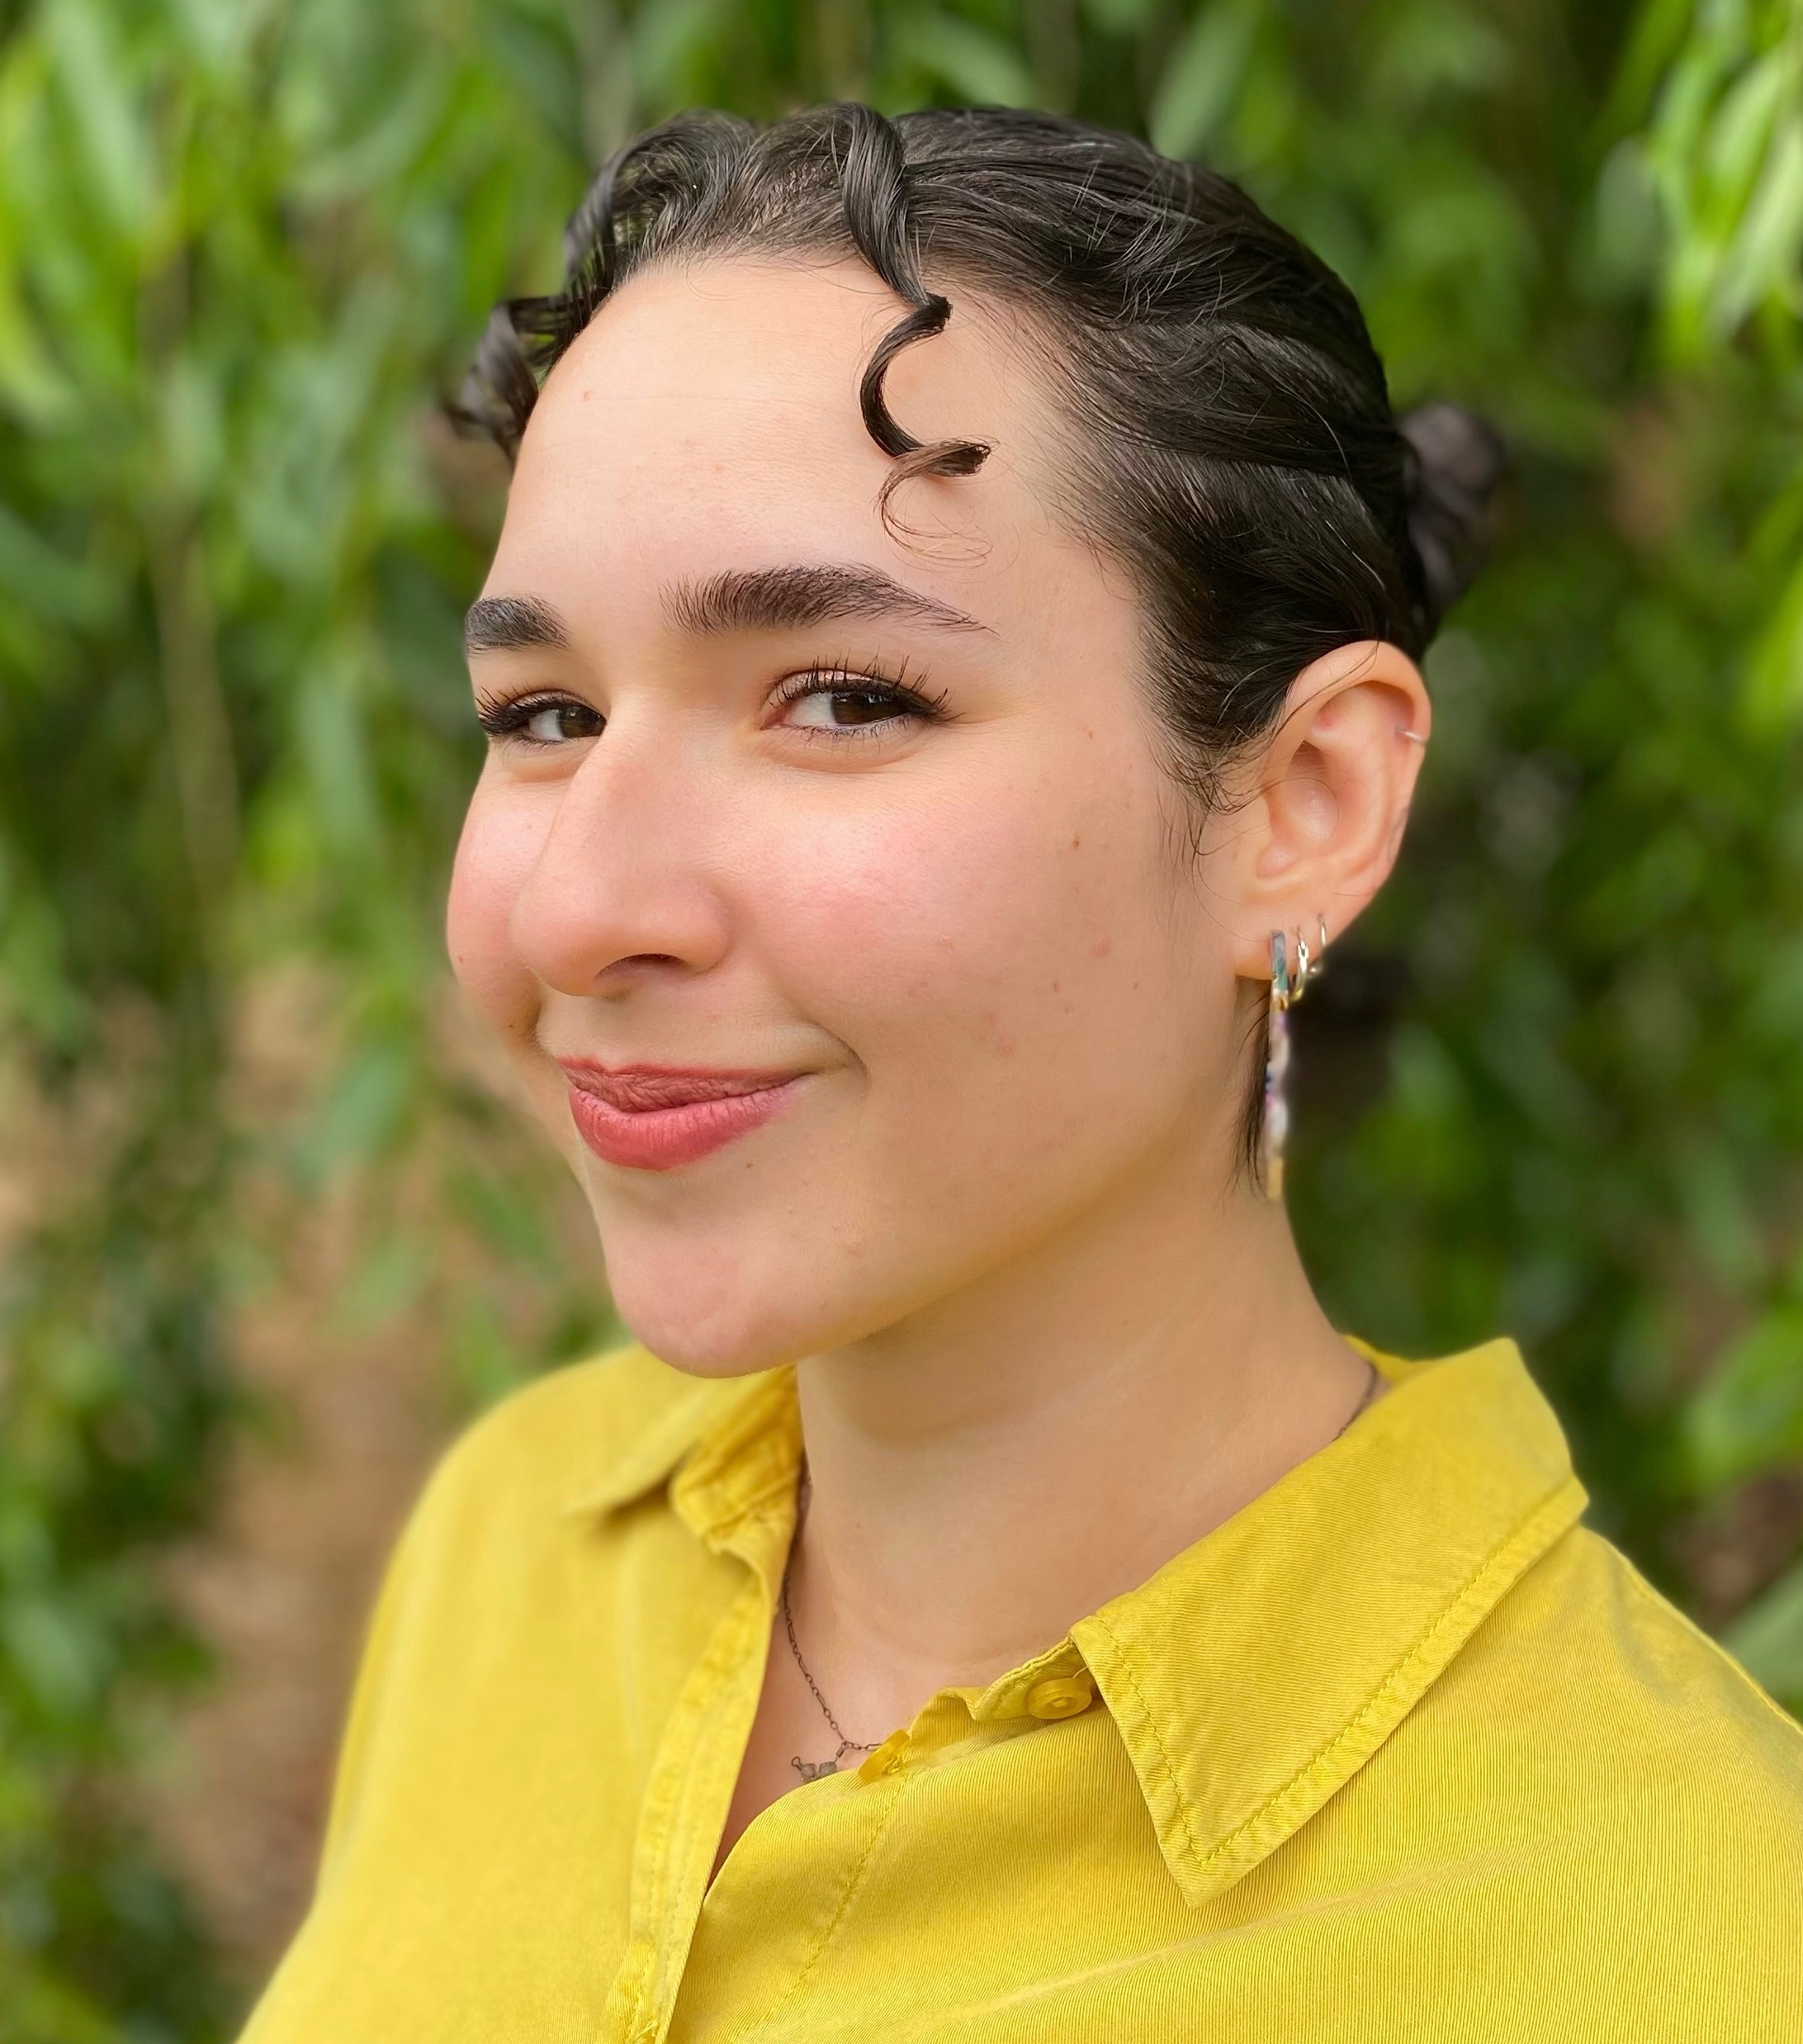

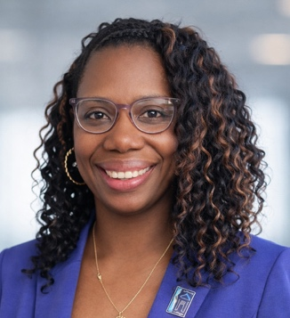

OFCY Evaluation Team
Kyrstal Jenkins
Site Visit Team and Analyst
Sharon McDonnell
Biostatistician / Data Manager
Dr. Katie Kramer
Project Director/PI
Lynda Murillo
Administrative Manager
Madeleine Frauix
Data Analyst
Danielle Motely-Lewis
Stakeholder Engagement, Site Visit
Summer Jackson
Group Facilitator

Slide 4
How the day is structured
01 | OFCY Welcome and Introductions | 9:30-9:45am
02 | Strengthening OFCY Outcome Reporting Presentation | 9:45-10:30am
03 | Breakout Group Session 1: Youth Leadership and Development Violence Prevention | 10:30-11:15am
04 | Breakout Group Session 2: High School & Post-Secondary Success Career Access and Employment for Opportunity Youth and Youth in School Oakland Summer Youth Employment | 11:30am-12:15pm
Notes:
Full-group presentation (all grantees together)
Strategy-specific breakout discussions later in the day
You are not expected to stay on Zoom all day
Times for the day Danielle
Intro Danielle for her part (MC)

Slide 5
Evaluation Updates
OFCY FY 24/25 Evaluation Report complete!
OFCY Participant Survey (year-round grantees) open April 13th – July 1st
  OUSD survey is currently active through March 20th for dually funded sites
OFCY Participant Survey (summer grantees) open June 1 – Sept 30th
Invitation email to agencies indicated interested in Beta Test on Feb 3rd
  Confirmation of participation requested by February 10th
Slides, handouts, and recordings emailed out after training
Weekly evaluation office hours, Thurs @ 9am-12pm starting Feb 26th

Slide 6

The Importance of a Collective OFCY Narrative

Slide 7


Roadmap of OFCY Evaluation Evolution
Descriptive Evaluation at Program Level
Where we’ve been
Pre 2024 – December 2024
Development of New Evaluation Plan
January – June 2025
Realignment of Evaluation with Oakland RBA Framework
Where we are
July – December 2025
Beta Test New Outcomes with Pilot Sites
January – June 2026
New Evaluation Implementation Under New RFP
Where we are going
July 2026 – June 2028
Collective Outcome Evaluation Across OFCY Portfolio
January 2027 – June 2028
Notes:
Descriptive Evaluation @ Program Level:
Output Data Across Portfolio (what we did, who we served)
Original OFCY Participant Survey
Program Level Self-Defined Outcomes
Redevelopment of Evaluation Plan
Ground outcomes in SIP 22-25
Examine what grantees are already reporting in Cityspan
Gather feedback (grantees/POC
Research PYD best practices to inform new outcomes
Proposed New Eval Plan/New outcomes
Gather feedback (grantees/POC)
Development and finalization of OFCY Evaluation Outcomes Plan
Realignment with City of Oakland RBA Framework
Goal: Enhance agency reporting to clearly demonstrate the outcomes of the collective OFCY programming
Align outcomes across COO departments in key strategy areas
Elevate participant voice
Improve collective storytelling
Defining clear and consistent outcome measurements across strategies
Beta Test New Outcomes at Pilot Sites
Internal test of Evaluation Plan to OFCY FY24/25 grantee outcomes data
Integration of outcomes & measures into OFCY 26/28 RFP
Beta test OFCY Evaluation Outcomes Plan with select OFCY FY 25/26 pilot sites
Provide training and TA to non-beta test sites to strengthen their current reporting in preparation for full roll out
Full Implementation of New Evaluation & Outcomes
Full integration and implementation of OFCY Evaluation Outcomes Plan with all new OFCY grantees under new RFP (FY26-28)
Collective Outcome Evaluation @ Across OFCY Portfolio Level
Complete and report on an evaluation that represents the collective outcome story across the entire OFCY portfolio
Continues to maintain room to share out individual and program level stories

Slide 8
Our North Star
Enhance OFCY reporting to clearly demonstrate impact of collective OFCY programming
Embrace City of Oakland RBA framework
Align outcomes across COO Departments in key strategy areas
Elevate participant voice
Improve collective storytelling
Define clear & consistent outcome measures across OFCY strategies
Notes:
From
Individual program-by-program reporting
Narrative/qualitative reporting
Previous efforts landed where they landed
Build on, lots of great stuff going on
Evolving - Taking it to the next level
To
More consistent reporting across programs, strategies, and all of OFCY
Learning from what sites have been reporting – use across the full OFCY
It’s a process, measured approach, learning as we go, iterative process

Slide 9
Collective and Comprehensive Storytelling Framework
Across All of OFCY
Across OFCY Strategies
Individual Programs
Notes:
From
Individual program-by-program reporting
Narrative/qualitative reporting
Previous efforts landed where they landed
Build on, lots of great stuff going on
Evolving - Taking it to the next level
To
More consistent reporting across programs, strategies, and all of OFCY
Learning from what sites have been reporting – use across the full OFCY
It’s a process, measured approach, learning as we go, iterative process

Slide 10
OFCY Results-Based Accountability Framework
How Much Did We Do?
Number of programs funded
Number of people served
Number of hours of service
Who we served (demographics)
How Well Did We Do It?
Actual compared to projected hours of service
Actual compared to project number of people served
Equity assessment (do people served represent communities with most disparities?)
Participant satisfaction
Is Anyone Better Off?
What quantity or quality of change for the better did we produce? (number or percent of people with improvement in skills, attitudes, behaviors, or circumstances)
Participants across OCFY report, display, or demonstrate improvements, such as:
  Percent (%) of youth participants reporting increased school readiness
  Percent (%) of parents who report increased parenting skills
  Number (#) of youth participants who gained paid internship or employment
Notes:
All OFCY agencies will report on outcomes in Q3 and Q4
While none, of this is mandatory, it is highly encouraged.
The work you do now, will help prepare you for the outcome reporting that will happen under the funded agencies under the new RFP.
This information will be presented in 4 ways

Slide 11
Now more than ever, we need to demonstrate the collective impact across all of OFCY.
Notes:
All OFCY agencies will report on outcomes in Q3 and Q4
While none, of this is mandatory, it is highly encouraged.
The work you do now, will help prepare you for the outcome reporting that will happen under the funded agencies under the new RFP.
This information will be presented in 4 ways

Slide 12

What is an outcome?

Slide 13
What is an outcome?
A meaningful and measurable change:
It answers the question:
In a child, youth, or parent/caregiver's experience (such as knowledge, skills, behavioral, or condition)
What is different for the child, youth, or family after participating in the OFCY program? (in other words, is anyone better off?)

Slide 14
What is not an outcome
Activities the Program Does
- E.g., held weekly classes, provided mentoring
- This information describes EFFORT, not IMPACT
Enrollment or Participation Numbers
– This information describes REACH, not CHANGE
This information is important, but it is not an outcome
- What program does = activities
- Who and how many people it serves = outputs
- How services were delivered = processes

Slide 15

Remember
If it describes a change in people's lives, it is likely an outcome.

Slide 16
“New” OFCY Outcome Categories
Belonging and Community Support
Knowledge Acquisition and Skill Development
Connections and Access to Resources
Leadership Development
Client Satisfaction
Engagement in School and Academic Support
Violence Prevention
Employment and Financial Stability
OTHER
Informed by OFCY Strategic Investment Plan & Review of Your OFCY Reporting in Cityspan

Slide 17
NEW: Selection of Outcome Category
Outcome Reporting Framework In Cityspan for FY 25/26
Progress Reports > Q3 & Q4 > Outcomes
NEW
Q1
Q3 & Q4
Strengthening
Suggestions
Outcome Category
Belonging & Support
Knowledge Acquisition & Skill Development
Outcome Description
Description of your outcome as input by your agency in Q1
Achieved?
Yes
No
How have you progressed? How do you know?
Focus on the participant
Leadership Development
Client Satisfaction
Engagement in School & Academic Support
Violence Prevention
Employment & Financial Stability
OTHER
Connections & Access to Resources
A few more data points
Provide details
Data source
Start with the #'s
Share even when outcome goals aren’t met

Slide 18
Key elements of a good outcome
Number of Youth or Families + Change Verb + Area of Change
Add a Measurable Number: 15 of 20 participants, 80%
of our participants
Helpful Change Verbs: Increase, improve, strengthen,
demonstrate, feel, identify
Identify Area of Change: Connect to OFCY Outcome
Categories (Belonging, Knowledge &
Skills, Connections & Resources,
Leadership, Client Satisfaction, Academic,
Violence Prevention, Employment, Other)

Slide 19
Examples of Measurable Outcomes
Example 1 : 75% of the 150 youth enrolled in our program increased their sense of leadership and confidence by participating in a leadership role (Leadership Development)
  Measurable Number = 75% of 150 youth
  Verb : increased sense of leadership and confidence
  Identified Area of Change: Leadership Development
Example 2: 25 of the 30 parents surveyed in our program reported they had improved their communication and problem-solving skills. (Knowledge Acquisition & Skill Development)
  Measurable Number = 25 of 30 parents surveyed
  Verb : improved communication and problem-solving skills
  Identified Area of Change: Knowledge Acquisition & Skill Development

Slide 20

Small changes = Large impact

Slide 21
Add denominators & numerators to your percentage
The denominator is the whole group
The numerator is the part of that group that demonstrated the change.
Example: 16 out of 20 parents (80%) in our program strengthened their ability to help their children be school-ready by receiving back-to-school supplies.
20 parents in total are in your program
So 20 is the denominator
16 of the parents received back-to-school supplies
So 15 is the numerator
16 of 20 = 80%

Slide 22
Add the Details
Reporting Example | Strengthening Tips
75% of our participants reported building positive relationships with their peers. | Provide the details on the numerator and the denominator before the percentage. Identify your data source 38 of 50 (75%) participants who took our program survey reported building positive relationships with their peers

Slide 23
Provide a Measurement Along with the Story
Reporting Example | Strengthening Tips
Over the past year, 6 participants were accepted into a leadership program and other competitive leadership initiatives. We’ve also seen students step into leadership roles within their schools, with 3 becoming student body presidents. These successes reflect not just participation in enrichment activities, but real transformation. When younger students witness alumni returning to lead and teach, they are motivated to follow in their footsteps. Our programs are not only building skills, they’re building leaders who give back and inspire others. Youth are increasingly taking initiative, whether by leading group activities, mentoring peers, or participating in specialized programs. Former students now in college return to lead classes in our program, offering real-time examples of growth and leadership in action. We track progress through participation levels, completed projects, and behavioral changes. Staff have observed increased confidence, improved communication, and a greater willingness among youth to take on responsibilities, speak publicly, and support others. These shifts reflect measurable development aligned with our goals. | Start with numbers (but keep the context). In total, 35 youth participated in our program this year. Of the 35, 25 youth (71%) took on leadership positions within the program, their schools, or their communities. (Leadership & Development) Examples of leadership accomplishments include XXX…

Slide 24
Provide a Measurement Along with the Story
Reporting Example | Strengthening Tips
This fiscal year, we have made significant strides in enhancing resource navigation for the youth we serve. Through the expansion of our services, participants have increased access to individualized support in areas such as health, education, employment, housing, and social services. Youth are now more easily able to meet one-on-one with staff to identify needs, set goals, and connect to appropriate community resources in a safe and supportive environment. Additionally, our programs have integrated resource navigation into their core programming, ensuring that youth learn how to access and utilize services themselves. Partnerships with community organizations have further expanded the range of opportunities and guidance available to participants. As a result, youth report feeling more confident in identifying and accessing the resources they need to support their personal, academic, and professional growth. This enhanced capacity to navigate resources has directly contributed to greater youth independence, resilience, and long-term stability, demonstrating that our OFCY-funded programming is effectively equipping participants with essential life skills and support networks. | Start with numbers (but keep the context). In total, 35 youth participated in our program this year. Of the 35, 25 youth (71%) received resource navigation support. A total of 150 resources were provided to these 25 youth. (connections and resources) Examples of resources provided include XXX…

Slide 25
Formalize Documentation (be creative)
Reporting Examples | Strengthening Tips
We have measured our outcomes by the feedback of our parents through each day they arrive to sign out their kids. We have a practice to communicate each day and talk to the families while they wait. on their children. Most of the feedback we received has been overwhelmingly positive. | Post a feedback board at sign-out to collect parent feedback. We received feedback from 210 parents. Of the feedback received, 200 (95%) parents provided positive feedback about their children’s experience in our program (client satisfaction)

Slide 26
Move From What you Did, to What is the Change?
Reporting Examples | Strengthening Tips
Provided 218 students with targeted academic support and interventions through Care Management for 56 youth; tutoring for 142 (84 of whom were international students); and Dual Enrollment participation by 20 students | XX total students were in the program this year Of this total number of students, 218 students (or XX%) participated in targeted academic support and interventions 56 received support through care management 142 students received support through tutoring (84 of whom were international students) 20 students received support through dual enrollment Of the 218 students who received academic support, XX students demonstrated improved academic achievement or academic readiness

Slide 27
What if our outcome isn’t really an outcome?
Such as staff training, program activities, which are more like program outputs
Consider how you can document the direct impact of program activities with participants.

Slide 28
Change an Output (Activity) Into an Outcome
Reporting Example | Strengthening Tips
Our staff worked more closely with students who were behind their grade level in reading and math. | Provide details about how many students. Staff identified 20 students who were behind in reading and math. Describe the change for your participants instead of what staff did. Of the 20 students identified as behind, 15 (75%) received additional support to strengthen their reading and math skills. (Engagement in School & Academic Support)

Slide 29
Change an Output (Activity) Into an Outcome
Reporting Example | Strengthening Tips
Outcome description: Youth will have access to participate in the program, which will increase exposure to practice academic skills, including using academic talk stems, making inferences, increasing the ability to understand complex text, and using evidence to make predictions. Outcome Report: This goal was met; the program took place once a week for both boys and girls in the program. | Provide details about how many students. A total of 80 students participated in our program this year. Describe the change for your participants beyond the happened. 80 of 80 (100%) students participating in our program practiced academic skills, including 50 students who provided academic talk stems. (Engagement in School & Academic Support)

Slide 30
Add “Data” to the Change You Describe
Reporting Example | Strengthening Tips
Our seminar lesson plans are designed to encourage and facilitate student self-reflection, collaboration with each other and fostering their leadership skills. We are able to assess this benchmark in our program through students' journal entries and increased participation during seminar discussions. Our student’s participation in lobbying opportunities and willingness to be interviewed also reflects our students’ improved public speaking skills and confidence around networking.. improved public speaking skills and confidence around networking. | Provide some “data” points to your narrative Clearly identify the change you are seeing A total of 80 students participated in our program 80 of these students (100%) demonstrated leadership and strengthened confidence by participating in lobbying opportunities Additionally, 45 of these students (56%) showed improved public speaking skills through their willingness and engagement in interviews (Leadership Development)

Slide 31
Other Strengthening Tips
Identify the source of your data (especially surveys)
  Results from our own survey show…
  Results we received from OUSD surveys indicate…
Quotes and stories are very important!
  Please report them in your narrative section
Even if you don’t meet your outcome goal…
  Share what information you do have (that’s important too!)
The Other Category is an option
  Outcomes that do not fit in the “standard outcome categories” and opportunity for agencies to maintain outcome measures unique to their programs

Slide 32
Weekly Evaluation Office Hours!
One-on-one individualized evaluation focused office hours
Thursdays @ 9am-12pm starting February 26th
45 min slots available first come, first serve
Opportunity to discuss site-specific questions or outcomes
Sign-up:
  Today with Lynda!
  Email Lynda: Lynda@thebridginggroup.com
  Link to sign-up

Slide 33
What’s Next?
Sign up for office hours for additional site-specific support and discussions
Main room remains open for support
Materials, including tip sheets, recordings, and slides, will be emailed after training
Complete training feedback form (after your breakout session)

Slide 34

Breakout Group Discussions
Share additional examples drawn directly from OFCY programs
Create space for cross-grantee sharing and discussion
Provide time for Q & A

Slide 35
Transition to Breakouts & Room Instructions
Breakouts are organized by OFCY-funded strategy
Approximately 40 minutes are allotted per breakout
Facilitators will guide discussion and keep time
Participation is encouraged by open discussion or using the chat
You will be placed into rooms automatically
If you are in the wrong room, let a facilitator know

Slide 36
Session 1: Breakout Room Assignments
Room 1
Leadership Development & Violence Prevention
Room 2
Leadership Development & Violence Prevention
Room 3
Leadership Development & Violence Prevention

Slide 37
How to Rename for Breakout Group II
Please rename yourself using the format below based on your funded strategy:
CA – OP – Participant Name
(Career Access & Employment – Opportunity Youth)
CA – YS – Participant Name
OR
YE – Participant Name
(Career Access & Employment – Youth in School / Oakland Summer Youth Employment)
HSS – Participant Name
(High School & Post-Secondary Student Success)

Slide 38
Session 2: Breakout Room Assignments
Room 1
High School & Post-Secondary Success
Room 2
Career Access & Employment for Opportunity Youth
Room 3
Career Access & Employment for Youth in School & Oakland Summer Youth Employment

Slide 39
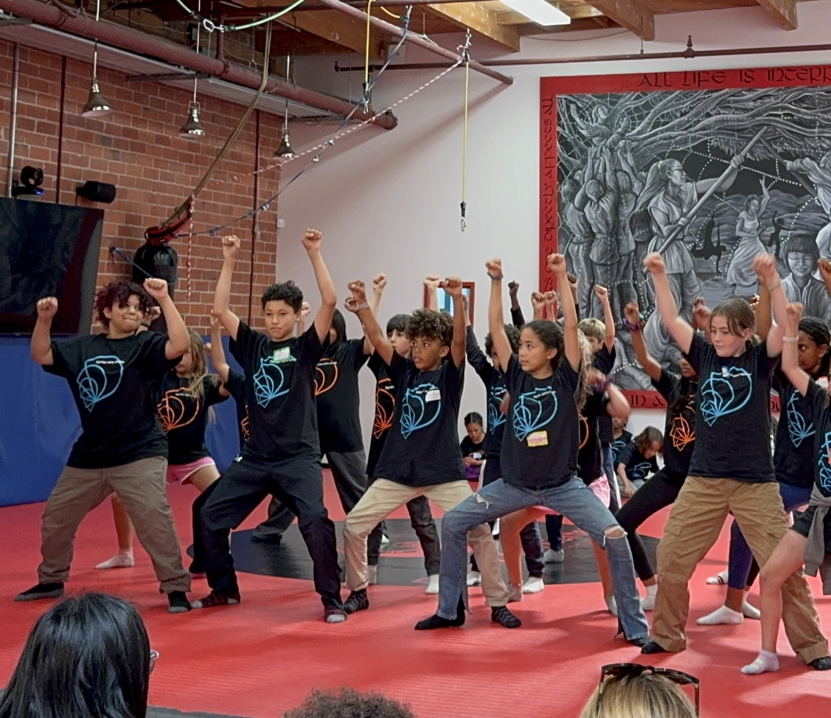
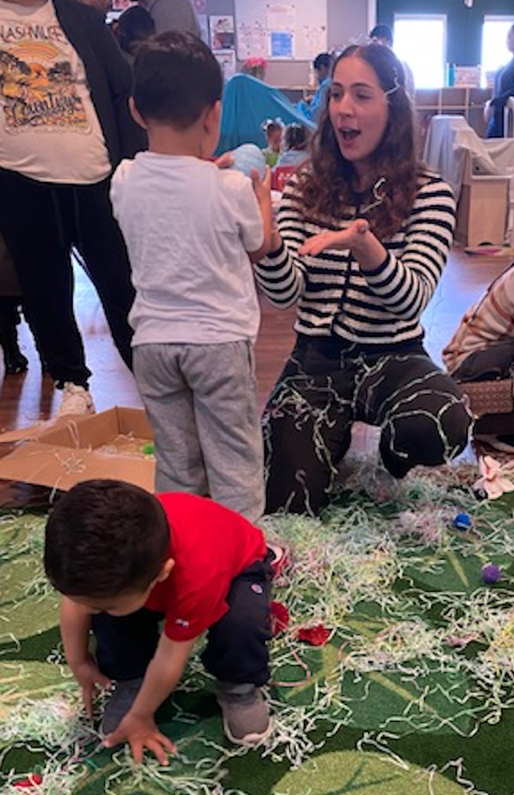

Katie Kramer
katie@thebridinggroup.com

