Slide 1


Strengthening OFCY Outcome Reporting
January 30, 2026
Presented by: The Bridging Group

Slide 2
Welcome & Opening Remarks
Robin Love, Child and Youth Services Manager

Slide 3

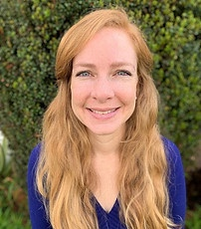
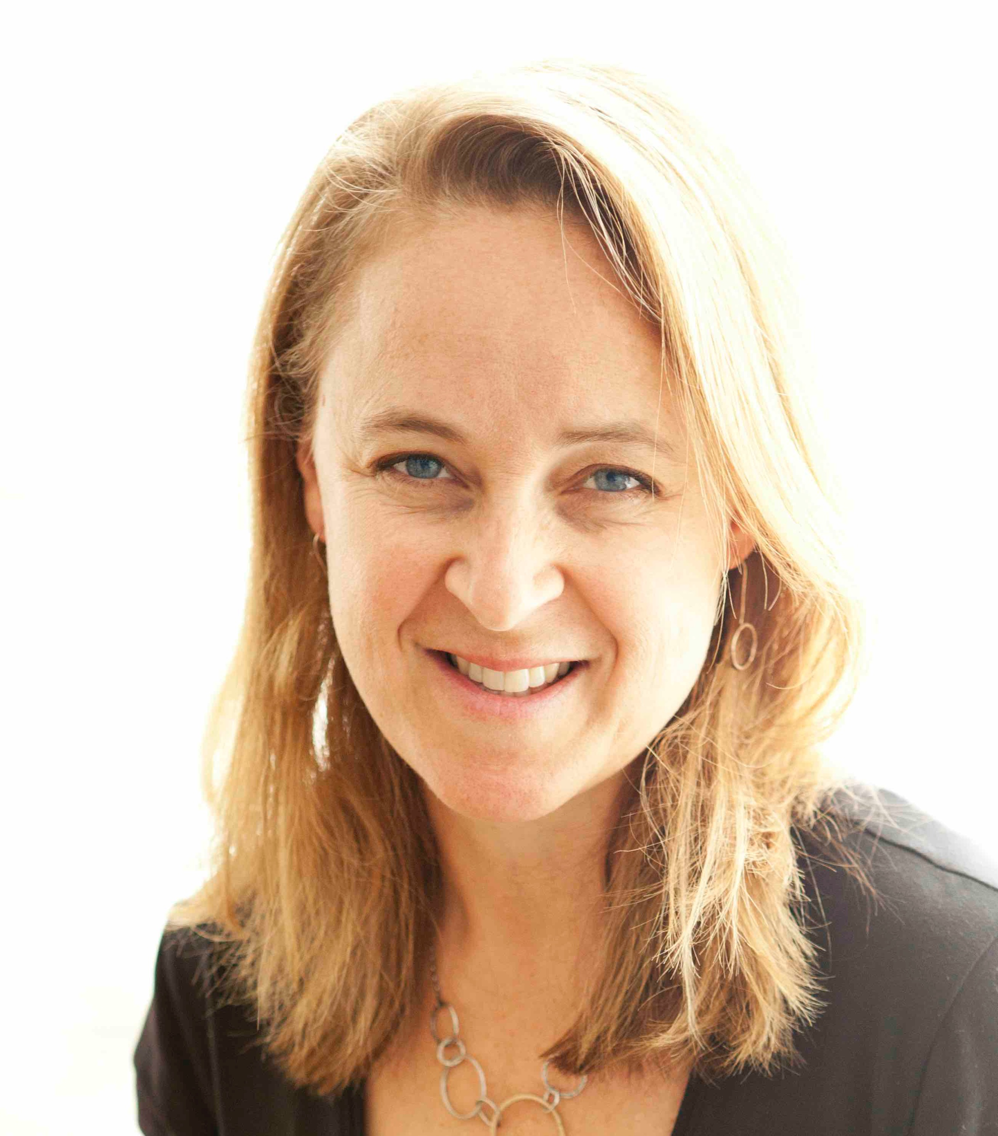
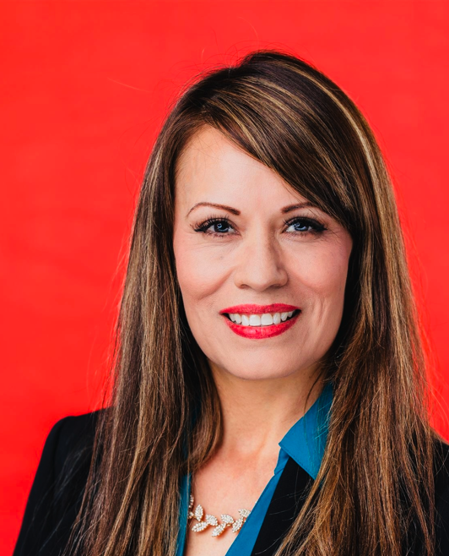
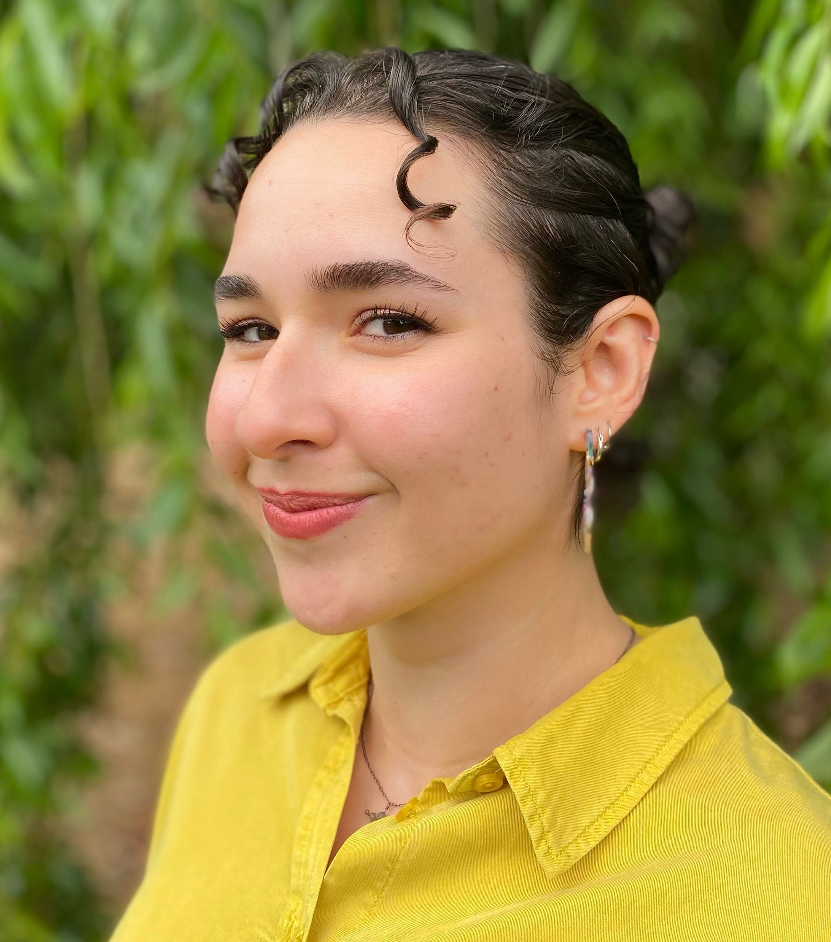

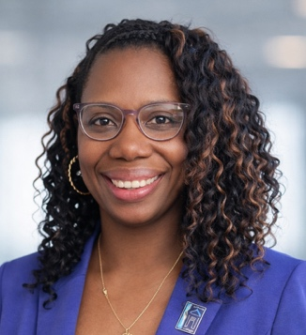

OFCY Evaluation Team
Kyrstal Jenkins
Site Visit Team and Analyst
Sharon McDonnell
Biostatistician / Data Manager
Dr. Katie Kramer
Project Director/PI
Lynda Murillo
Administrative Manager
Madeleine Frauix
Data Analyst
Danielle Motely-Lewis
Stakeholder Engagement, Site Visit
Summer Jackson
Group Facilitator
Notes:
KEEP OR DELETE?

Slide 4
How the day is structured
01 | OFCY Welcome and Introductions | 10:00-10:15am
02 | Strengthening OFCY Outcome Reporting Presentation | 10:15-11:00am
03 | Breakout Group 1: After-school Middle Schools & Middle School Engagement & Wellness | 11:00-11:45m
04 | Breakout Group 2: FRCs and SEWIEC | 12:30-1:15pm
05 | Breakout Group 3: After-school Elementary Schools & Summer Academic & Enrichment | 1:30-2:15pm
Notes:
Full-group presentation (all grantees together)
Strategy-specific breakout discussions later in the day
You are not expected to stay on Zoom all day
Times for the day Danielle
Intro Danielle for her part (MC)

Slide 5
Evaluation Updates
OFCY FY 24/25 Evaluation Report complete!
OFCY Participant Survey (year-round grantees) open April 13th – July 1st
  OUSD survey is currently active through March 20th for dually funded sites
OFCY Participant Survey (summer grantees) open June 1 – Sept 30th
Invitation email to agencies indicated interested in Beta Test on Feb 3rd
  Confirmation of participation requested by February 10th
Slides, handouts, and recordings emailed out after training
Weekly evaluation office hours, Thurs @ 9am-12pm starting Feb 26th
Next week’s training (Feb 6th) same content (no need to attend)

Slide 6

The Importance of a Collective OFCY Narrative

Slide 7


Roadmap of OFCY Evaluation Evolution
Descriptive Evaluation at Program Level
Where we’ve been
Pre 2024 – December 2024
Development of New Evaluation Plan
January – June 2025
Realignment of Evaluation with Oakland RBA Framework
Where we are
July – December 2025
Beta Test New Outcomes with Pilot Sites
January – June 2026
New Evaluation Implementation Under New RFP
Where we are going
July 2026 – June 2028
Collective Outcome Evaluation Across OFCY Portfolio
January – June 2026
Notes:
Descriptive Evaluation @ Program Level:
Output Data Across Portfolio (what we did, who we served)
Original OFCY Participant Survey
Program Level Self-Defined Outcomes
Redevelopment of Evaluation Plan
Ground outcomes in SIP 22-25
Examine what grantees are already reporting in Cityspan
Gather feedback (grantees/POC
Research PYD best practices to inform new outcomes
Proposed New Eval Plan/New outcomes
Gather feedback (grantees/POC)
Development and finalization of OFCY Evaluation Outcomes Plan
Realignment with City of Oakland RBA Framework
Goal: Enhance agency reporting to clearly demonstrate the outcomes of the collective OFCY programming
Align outcomes across COO departments in key strategy areas
Elevate participant voice
Improve collective storytelling
Defining clear and consistent outcome measurements across strategies
Beta Test New Outcomes at Pilot Sites
Internal test of Evaluation Plan to OFCY FY24/25 grantee outcomes data
Integration of outcomes & measures into OFCY 26/28 RFP
Beta test OFCY Evaluation Outcomes Plan with select OFCY FY 25/26 pilot sites
Provide training and TA to non-beta test sites to strengthen their current reporting in preparation for full roll out
Full Implementation of New Evaluation & Outcomes
Full integration and implementation of OFCY Evaluation Outcomes Plan with all new OFCY grantees under new RFP (FY26-28)
Collective Outcome Evaluation @ Across OFCY Portfolio Level
Complete and report on an evaluation that represents the collective outcome story across the entire OFCY portfolio
Continues to maintain room to share out individual and program level stories

Slide 8
Collective and Comprehensive Storytelling Framework
Across All of OFCY
Across OFCY Strategies
Individual Programs
Notes:
From
Individual program-by-program reporting
Narrative/qualitative reporting
Previous efforts landed where they landed
Build on, lots of great stuff going on
Evolving - Taking it to the next level
To
More consistent reporting across programs, strategies, and all of OFCY
Learning from what sites have been reporting – use across the full OFCY
It’s a process, measured approach, learning as we go, iterative process

Slide 9
Our North Star
Enhance OFCY reporting to clearly demonstrate impact of collective OFCY programming
Embrace City of Oakland RBA framework
Align outcomes across COO Departments in key strategy areas
Elevate participant voice
Improve collective storytelling
Define clear & consistent outcome measures across OFCY strategies
Notes:
From
Individual program-by-program reporting
Narrative/qualitative reporting
Previous efforts landed where they landed
Build on, lots of great stuff going on
Evolving - Taking it to the next level
To
More consistent reporting across programs, strategies, and all of OFCY
Learning from what sites have been reporting – use across the full OFCY
It’s a process, measured approach, learning as we go, iterative process

Slide 10
Now more than ever, we need to demonstrate the collective impact across all OFCY.

Slide 11
OFCY Results-Based Accountability Framework
How Much Did We Do?
Number of programs funded
Number of people served
Number of hours of service
Who we served (demographics)
How Well Did We Do It?
Actual compared to projected hours of service
Actual compared to project number of people served
Equity assessment (do people served represent communities with most disparities?)
Participant satisfaction
Is Anyone Better Off?
What quantity or quality of change for the better did we produce? (number or percent of people with improvement in skills, attitudes, behaviors, or circumstances)
Participants across OCFY report, display, or demonstrate improvements, such as:
  Percent (%) of youth participants reporting increased school readiness
  Percent (%) of parents who report increased parenting skills
  Number (#) of youth participants who gained paid internship or employment
Notes:
All OFCY agencies will report on outcomes in Q3 and Q4
While none, of this is mandatory, it is highly encouraged.
The work you do now, will help prepare you for the outcome reporting that will happen under the funded agencies under the new RFP.
This information will be presented in 4 ways

Slide 12

What is an outcome?

Slide 13
What is an outcome?
A meaningful and measurable change:
It answers the question:
In a child, youth, or parent/caregiver's experience (such as knowledge, skills, behavioral, or condition)
What is different for the child, youth, or family after participating in the OFCY program? (in other words, is anyone better off?)

Slide 14
What is not an outcome
Activities the Program Does
- E.g., held weekly classes, provided mentoring
- This information describes EFFORT, not IMPACT
Enrollment or Participation Numbers
– This information describes REACH, not CHANGE
This information is important, but it is not an outcome
- What program does = activities
- Who and how many people it serves = outputs
- How services were delivered = processes

Slide 15

Remember
If it describes a change in people's lives, it is likely an outcome.

Slide 16
NEW: Selection of Outcome Category
Outcome Reporting Framework In Cityspan
Progress Reports > Q3 & Q4 > Outcomes
NEW
Strengthening
Suggestions
Outcome Category
Belonging & Support
Knowledge Acquisition & Skill Development
Outcome Description
Description of your outcome as input by your agency in Q1
Achieved?
Yes
No
How have you progressed? How do you know?
Focus on the participant
Leadership Development
Client Satisfaction
Engagement in School & Academic Support
Violence Prevention
Employment & Financial Stability
OTHER
Connections & Access to Resources
A few more data points
Provide details
Data source
Start with the #'s
Share even when goals aren’t met

Slide 17
Key elements of a good outcome
Number of Youth or Families + Change Verb + Area of Change
Add a Measurable Number: 15 of 20 participants, 80% of our participants
Helpful verbs: increase, improve, strengthen, demonstrate, feel, identify
Identify Area of Change: connected to OFCY Outcome Categories
(Belonging. Knowledge & Skills, Connections & Resources, Leadership, Client Satisfaction, Academic, Violence Prevention, Employment, Other)

Slide 18
Examples of Measurable Outcomes
Example 1 : 75% of the 150 youth enrolled in our program increase confidence by participating in a leadership role (Leadership Development)
  Measurable Number = 75% of 150 youth
  Verb : increase confidence
  Identified Area of Change: Leadership Development
Example 2: 25 of the 30 parents surveyed in our program reported they had improved their communication and problem-solving skills. (Knowledge Acquisition & Skill Development)
  Measurable Number = 25 of 30 parents surveyed
  Verb : improved communication and problem-solving skills
  Identified Area of Change: Knowledge Acquisition & Skill Development

Slide 19

Small changes = Large impact

Slide 20
Add denominators & numerators to your percentage
The denominator is the whole group
The numerator is the part of that group that demonstrated the change.
Example: 15 out of 20 parents (75%) in our program strengthened their ability to help their children be school-ready by receiving back-to-school supplies.
20 parents in total are in your program
So 20 is the denominator
15 of the parents received back-to-school supplies
So 15 is the numerator
15 of 20 = 75%

Slide 21
NEW: Selection of Outcome Category
Outcome Reporting Framework In Cityspan
Progress Reports > Q3 & Q4 > Outcomes
Outcome Category
Belonging & Support
Knowledge Acquisition & Skill Development
Outcome Description
Parents in our program will strengthen their ability to support their children’s early learning and school readiness by receiving support and resources.
Achieved?
Yes
How have you progressed? How do you know?
15 out of 20 parents (75%) in our program strengthened their ability to help their children be school-ready by receiving back-to-school supplies.
Leadership Development
Client Satisfaction
Engagement in School & Academic Support
Violence Prevention
Employment & Financial Stability
OTHER
Connections & Access to Resources

Slide 22
Add the Details
Reporting Example | Strengthening Tips
75% of our participants reported building positive relationships with their peers. | Provide the details on the numerator and the denominator before the percentage. Identify your data source 38 of 50 (75%) participants who took our program survey reported building positive relationships with their peers

Slide 23
Provide a Measurement Along with the Story
Reporting Example | Strengthening Tips
Over the past year, 6 participants were accepted into a leadership program and other competitive leadership initiatives. We’ve also seen students step into leadership roles within their schools, with 3 becoming student body presidents. These successes reflect not just participation in enrichment activities, but real transformation. When younger students witness alumni returning to lead and teach, they are motivated to follow in their footsteps. Our programs are not only building skills, they’re building leaders who give back and inspire others. Youth are increasingly taking initiative, whether by leading group activities, mentoring peers, or participating in specialized programs. Former students now in college return to lead classes in our program, offering real-time examples of growth and leadership in action. We track progress through participation levels, completed projects, and behavioral changes. Staff have observed increased confidence, improved communication, and a greater willingness among youth to take on responsibilities, speak publicly, and support others. These shifts reflect measurable development aligned with our goals. | Start with numbers (but keep the context). In total, 35 youth participated in our program this year. Of the 35, 25 youth (71%) took on leadership positions within the program, their schools, or their communities. (Leadership & Development) Examples of leadership accomplishments include XXX…

Slide 24
Formalize Documentation (be creative)
Reporting Examples | Strengthening Tips
We have measured our outcomes by the feedback of our parents through each day they arrive to sign out their kids. We have a practice to communicate each day and talk to the families while they wait. on their children. Most of the feedback we received has been overwhelmingly positive. | Post a feedback board at sign-out to collect parent feedback. We received feedback from 210 parents. Of the feedback received, 200 (95%) parents provided positive feedback about their children’s experience in our program (client satisfaction)

Slide 25
What if our outcome isn’t really an outcome?
Such as staff training, program activities, which are more like program outputs
Consider how you can document the direct impact of program activities with participants.

Slide 26
Change an Output (Activity) Into an Outcome
Reporting Example | Strengthening Tips
Our staff worked more closely with students who were behind their grade level in reading and math. | Provide details about how many students. Staff identified 20 students who were behind in reading and math. Describe the change for your participants instead of what staff did. Of the 20 students identified as behind, 15 (75%) received additional support to strengthen their reading and math skills. (Engagement in School & Academic Support)

Slide 27
Change an Output (Activity) Into an Outcome
Reporting Example | Strengthening Tips
Outcome description: Youth will have access to participate in the program, which will increase exposure to practice academic skills, including using academic talk stems, making inferences, increasing the ability to understand complex text, and using evidence to make predictions. Outcome Report: This goal was met; the program took place once a week for both boys and girls in the program. | Provide details about how many students. A total of 80 students participated in our program this year. Describe the change for your participants beyond the happened. 80 of 80 (100%) students participating in our program practiced academic skills, including 50 students who provided academic talk stems. (Engagement in School & Academic Support)

Slide 28
Other Strengthening Tips
Identify the source of your data (especially surveys)
  Results from our own survey show…
  Results we received from OUSD surveys indicate…
Quotes and stories are very important!
  Please report them in your narrative section
Even if you don’t meet your outcome goal…
  Share what information you do have (that’s important too!)
The Other Category is an option
  Outcomes that do not fit in the “standard outcome measures” and opportunity for agencies to maintain outcome measures unique to their programs

Slide 29
Weekly Evaluation Office Hours!
One-on-one individualized evaluation focused office hours
Thursdays @ 9am-12pm starting February 26th
45 min slots available first come, first serve
Sign-up:
  Today with Lynda!
  Email Lynda: Lynda@thebridginggroup.com
  Link to sign-up

Slide 30

Breakout Group Discussions
Share additional examples drawn directly from OFCY programs
Create space for cross-grantee sharing and discussion
Provide time for Q & A

Slide 31
Transition to Breakouts & Room Instructions
Breakouts are organized by OFCY-funded strategy
Approximately 40 minutes are allotted per breakout
Facilitators will guide discussion and keep time
Participation is encouraged by open discussion or using the chat
You will be placed into rooms automatically
If you are in the wrong room, let a facilitator know

Slide 32
What’s Next?
Sign up for office hours for additional site-specific support and discussions
Main room remains open for support
Materials, including tip sheets, recordings, and slides, will be emailed after training

Slide 33
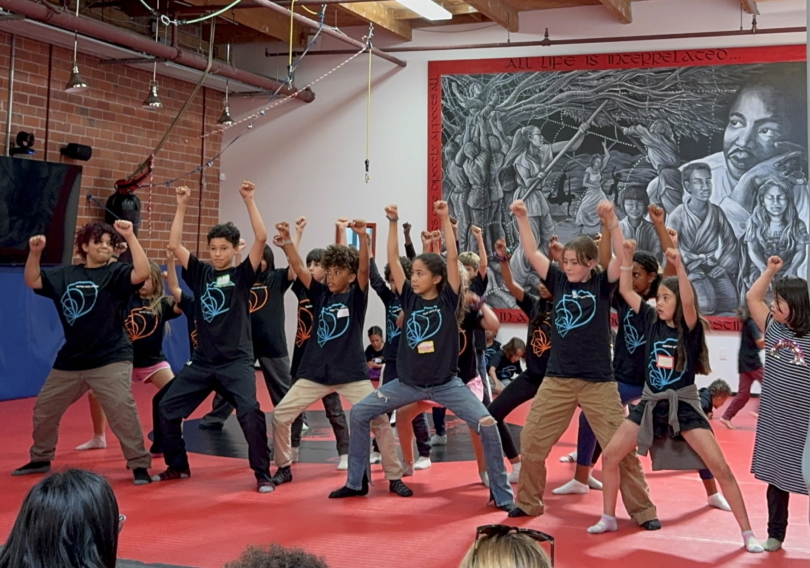
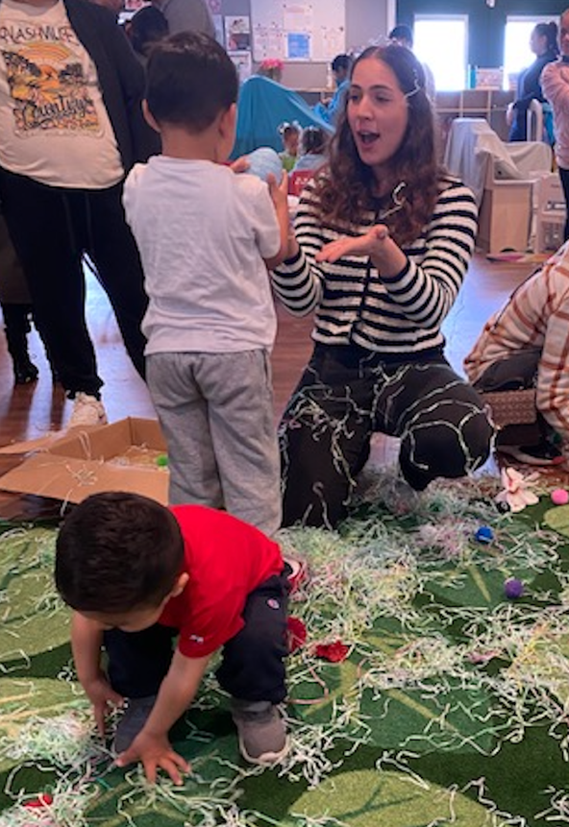
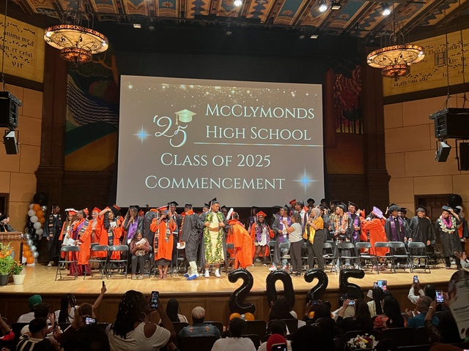
Katie Kramer
katie@thebridinggroup.com

