Slide 1


2024-2025 Overview

Slide 2

OFCY
Kids First!
The Oakland Fund for Children and Youth was established in November 1996.
Oakland voters passed the Kids First! Initiative, amending the City Charter to set aside three percent (3%) of the City’s annual unrestricted General-Purpose Fund to support direct services to youth under 21 years of age for a twelve-year period.
History

Slide 3
Oakland City
Charter Article XIII:
Kids First! Oakland Children’s Fund

Slide 4

In 2009, Oakland voters reauthorized the Kids First! Initiative second twelve-year period to require a Three-Year Strategic Investment Plan to guide the allocation of funds.
On March 3, 2020, City Council adopted Ordinance No. 13588 C.M.S., extending OFCY for another twelve-year period, from July 1, 2021, through June 30, 2033.

Slide 5
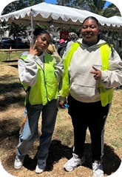

Slide 6

Monies are to be used exclusively to:
Support the healthy development of young children
Help children and youth succeed in school and graduate high school
Prevent and reduce violence, crime, and gang involvement among children and youth
Help youth transition to productive adulthood

Slide 7

OFCY submits to Oakland’s City Council a Three-Year Strategic Investment Plan and corresponding program funding recommendations
OFCY solicits program funding proposals from private non-profit and public agencies through an open and fair application process called Request for Proposal (RFP)

Slide 8

Vision: All children and youth in Oakland will thrive and have the support of the entire community to lead safe, healthy and productive lives.
Mission: We provide strategic funding to support Oakland’s children and youth from birth to 20 years of age to become healthy, happy, educated, engaged, powerful and loved community members.
Vision, Mission & Values

Slide 9
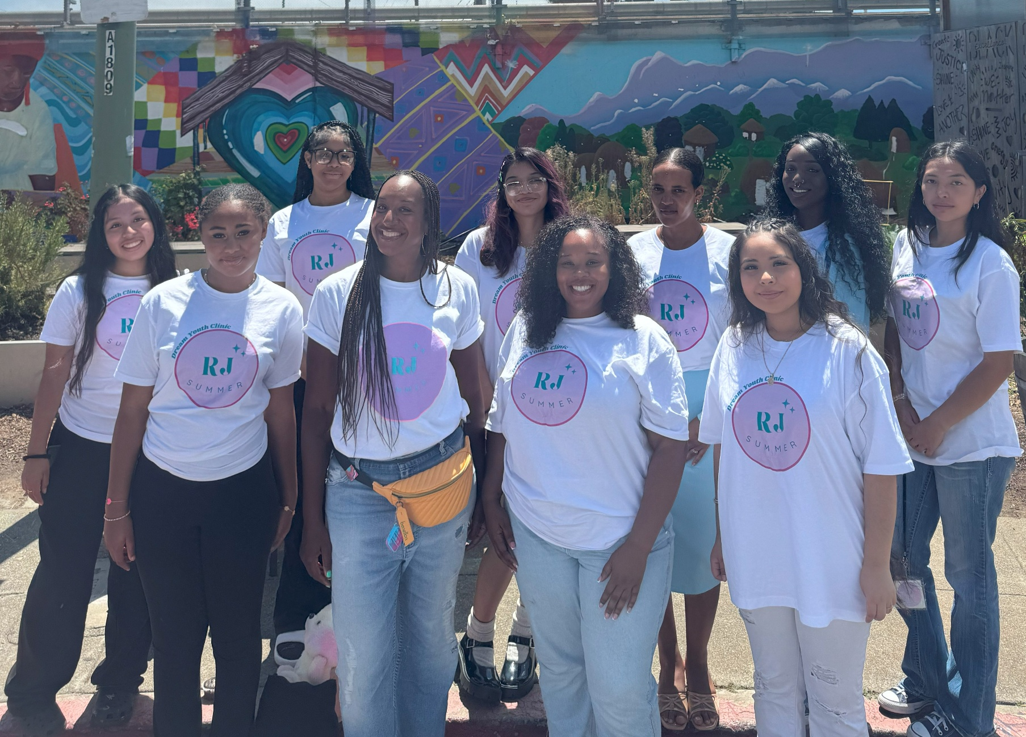
Values
Social and Economic Equity
All children and youth have a fundamental right for a safe and healthy life and a quality education. We value the concerted application of our resources toward those youth in greatest need.
Child and Youth Development
We support efforts to promote the social, emotional, physical, cognitive & spiritual development of children and to instill individual and community pride & leadership.
Community and Collaboration
We embrace the idea that by pooling our resources and working together, we can accomplish great things.
Vision, Mission & Values

Slide 10
OFCY Funding

Slide 11
OFCY Funding - FY 2023-2024
Funding Strategy | # of Programs | Annual Funding
1. Social-Emotional Well-Being in Early Childhood | 5 | $775,000
2. Family Resource Centers and Parent Engagement | 10 | $2,261,035
3. Comprehensive School-Based Afterschool at Elementary Schools | 39 | $3,230,000
4. Comprehensive School-Based Afterschool at Middle Schools | 15 | $1,500,000
5. Middle School Engagement, Wellness, and Transitions | 5 | $710,000
6. High School and Post-Secondary Student Success | 11 | $1,245,000
7. Youth Leadership and Development | 33 | $4,645,000
8. Summer Academic & Enrichment Programs + Summer Youth Employment | 12 | $1,161,000
9. Violence Prevention Programming | 3 | $655,000
10. Career Access and Employment for Opportunity Youth | 9 | $1,660,000
11. Career Access and Employment for Youth in School | 6 | $995,000
20
Total 148
$18,837,035

Slide 12
OFCY Programs

Slide 13
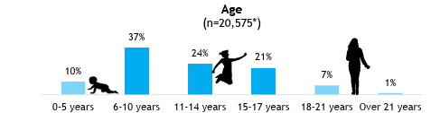
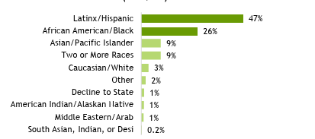
OFCY FY23-24 Programs Projected Children 0-21 years
20,612 children and youth were served across 148 programs in FY 23-24

Slide 14
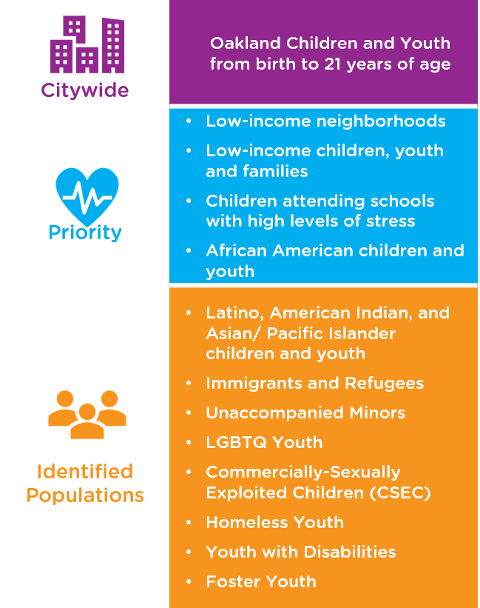
OFCY 2025-2028
Strategic Investment Plan

Slide 15
Timeline

Slide 16

OFCY
Three-Year Grant Cycle
Year #3
RFP, Review Process & Awarding Grants
Year #1
Onboarding Grantees
Year#2 Strategic Planning

Slide 17
POC Meeting Schedule 2025-2026
POC Meetings take place on the 1st and/or 3^{rd*} Wednesday of the month
Month/Year | First Wednesday | Third Wednesday
July 2025 | July 2, 2025 | July 16, 2025
August 2025 | RECESS | RECESS
September 2025 | September 3, 2025 | September 17, 2025
October 2025 | October 1, 2025 | October 15, 2025
November 2025 | November 5, 2025 | November 19, 2025
December 2025 | December 3, 2025 | December 17, 2025
January 2026 | January 7, 2026 | January 21, 2026
February 2026 | February 4, 2026 | February 18, 2026
March 2026 | March 4, 2026 | March 18, 2026
April 2026 | April 1, 2026 | April 15, 2026
May 2026 | May 6, 2026 | May 20, 2026
June 2026 | June 3, 2026 | June 17, 2026
July 2026 | July 1, 2026 | July 15, 2026

Slide 18
POC Governance

Slide 19

The POC has subcommittees to perform specific tasks and functions.
There is one standing subcommittee – the Evaluation Subcommittee.
The POC also forms ad-hoc subcommittees when needed. These have included ad-hoc subcommittees for Strategic Planning, Review, and Appeals.
The following POC Bylaws:
Term of Appointment
Meeting Attendance
Conflict of Interest
Election of Co-Chairpersons
Planning and Oversight Committee
Subcommittees

Slide 20

Rosenberg’s Rules of Order are an updated and simplified version of Robert’s Rules of Order. They provide guidance for understanding parliamentary procedure, which is a set of rules for conduct used at POC (and other governmental) meetings.
The Ralph M. Brown Act, was an act of the California State Legislature, authored by Assembly member Ralph M. Brown and passed in 1953, that guaranteed the public’s right to attend and participate in meetings of local legislative bodies.
AB 2449 – Teleconferencing Requirements, document courtesy of Sonoma County Transportation Authority. AB 2449 expires January 1, 2026.
The City of Oakland Sunshine Ordinance Act was “intended in part to clarify and supplement the Ralph M. Brown Act and the California Public Records Act to assure that the people of the City of Oakland can be fully informed and thereby retain control over the instruments of local government in their city.”
Governance
&
Oversight

Slide 21

Provides a minimum of two minutes per speaker per item, subject to chair discretion. Chair must announce
reasons publicly if there is any reduction in time.
Must permit speakers to address an item before final vote.
Must permit "open forum" during regular and special meetings.
May not prevent criticism of procedures, programs, acts or omissions.
Must adopt speaker rules which are "reasonable and uniformly applied”.
Public
Participation

Slide 22
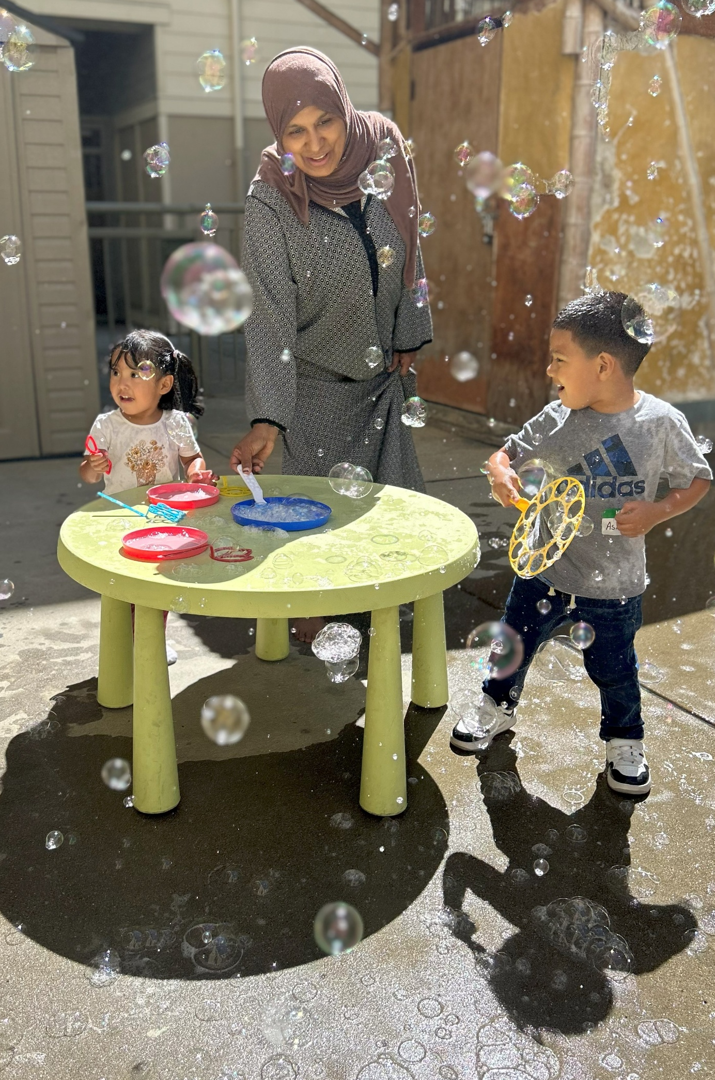
OFFICE LOCATION:
150 Frank H. Ogawa Plaza, Suite 1426
Oakland CA 94612
510-238-3088
HOURS:
Monday-Friday: 8:00AM-5:00PM
WEBSITE:
www.ofcy.org

