Slide 1


Oakland Fund for Children and Youth
System Development 2023-24

Slide 2


New Development Highlights
Attendance Import Tool
Address Geocoding & Geographic Reporting
System Dashboards
PDF reports with Visual Representations

Slide 3

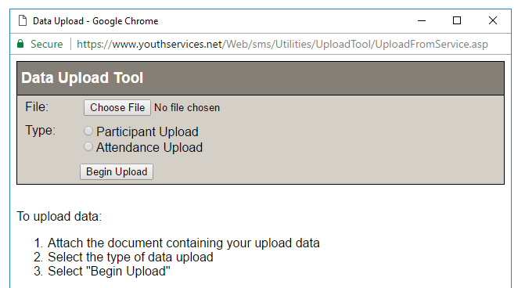

Attendance Import Tool
Attendance Upload Workflow

Slide 4
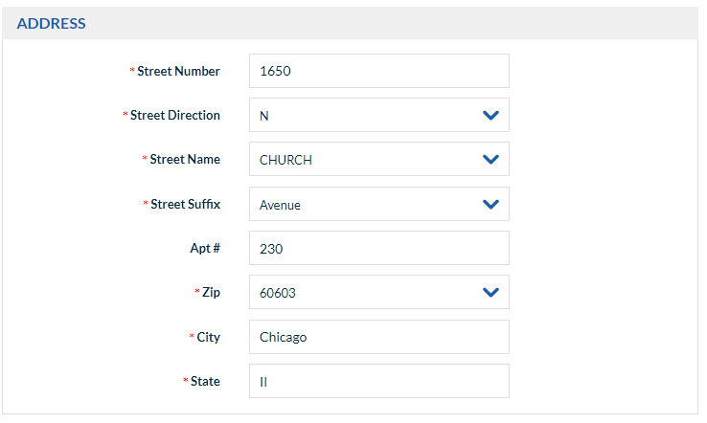
GIS Address Validation

Slide 5
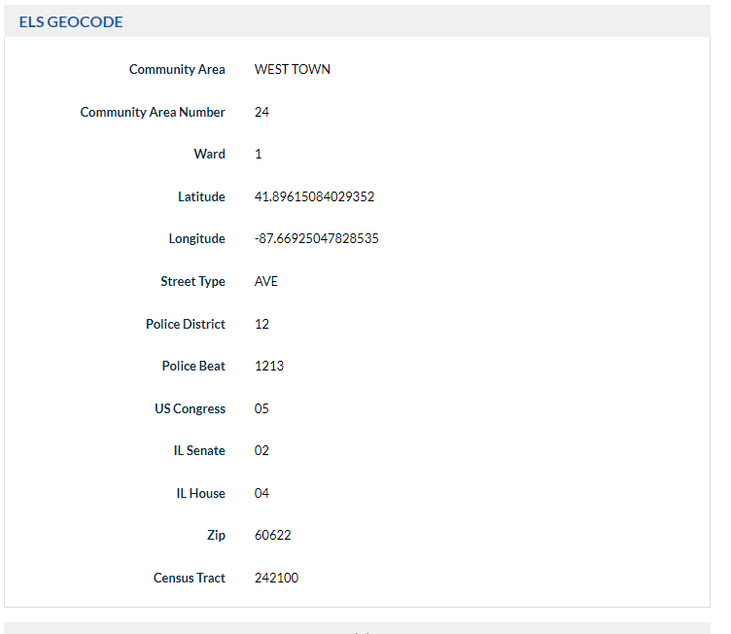
Address Geocoding

Slide 6
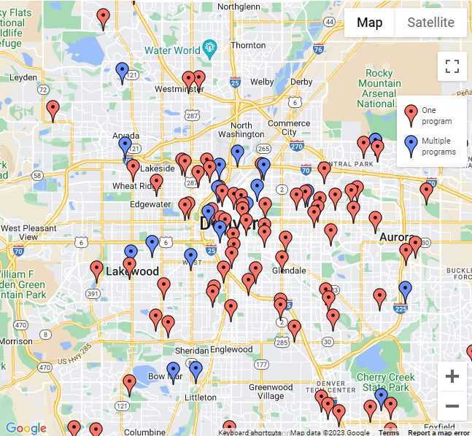
Geographic Mapping & Reporting

Slide 7
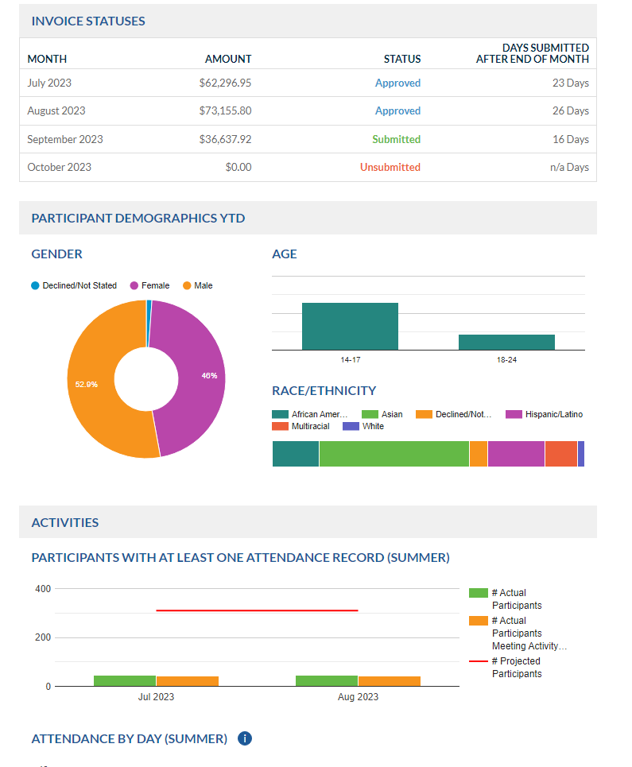
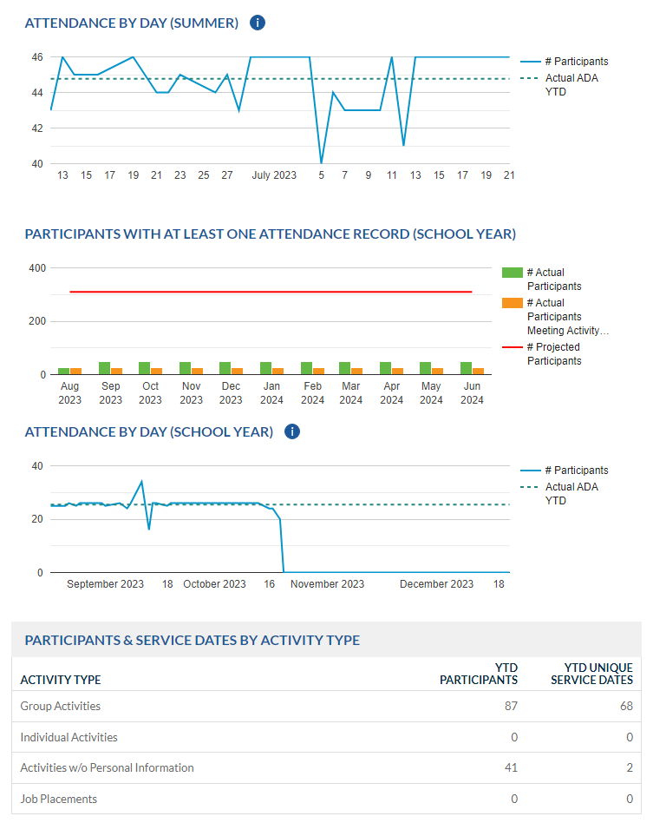
System Dashboards

Slide 8
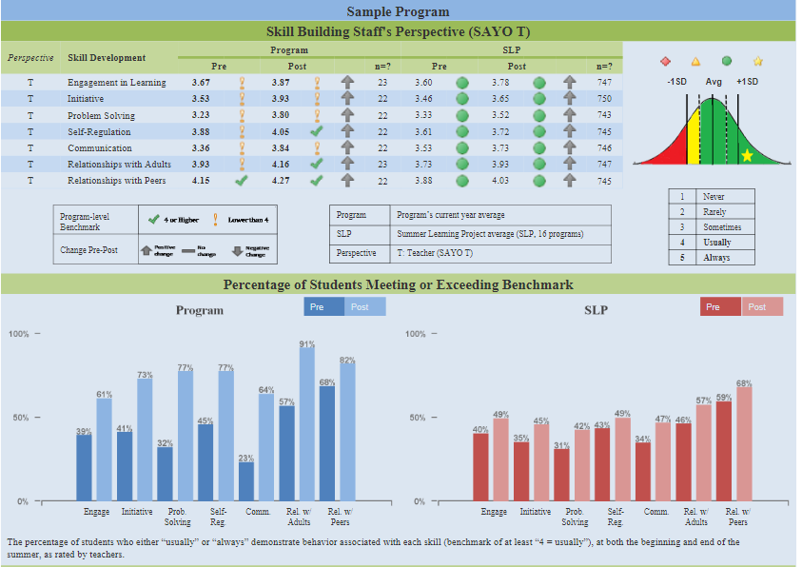
PDF Reports with Visualizations

Slide 9
Reminders and Updates
Program Contact Information Form
OUSD Participant and Attendance Import

Slide 10
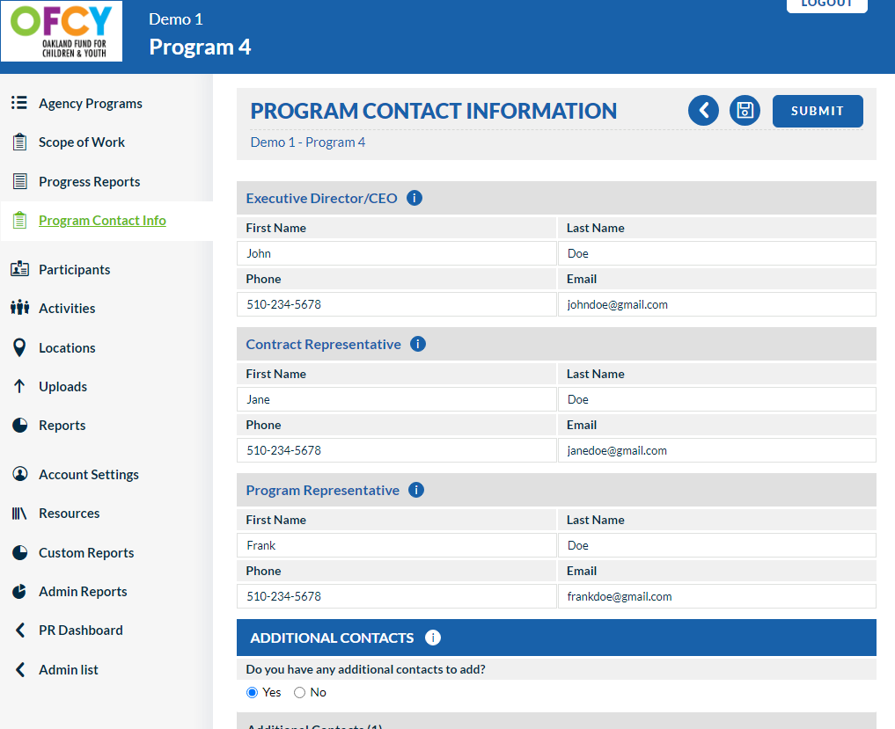
Program Contact Information

Slide 11
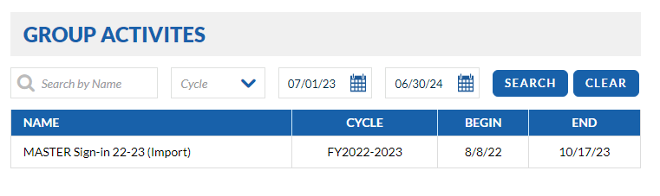
OUSD Import

